Slide 1
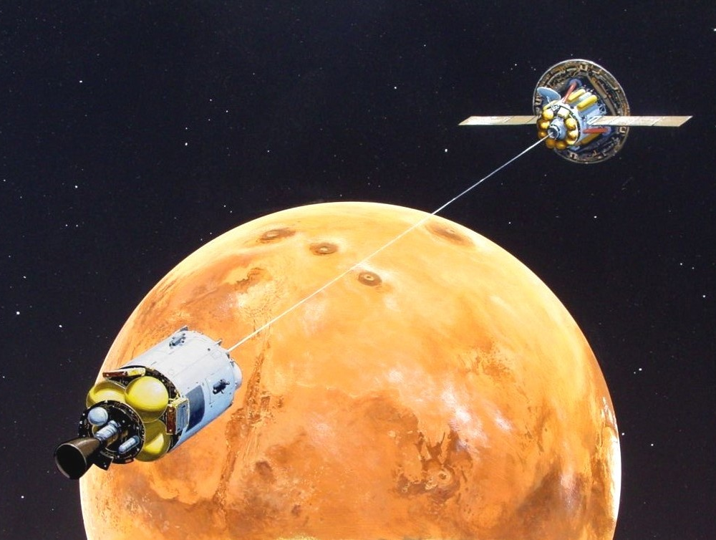
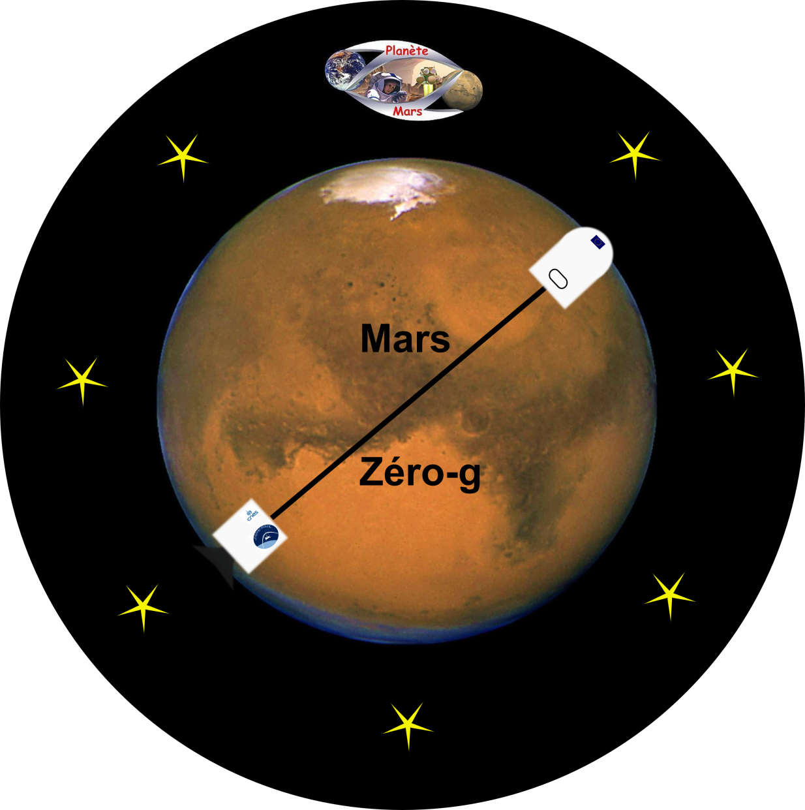
Mars Zéro-g
13th Mars Society European Conference

Slide 2
Plan
The project
The conception
The general idea
The demonstrator
The launcher
The flight
The results
Possible ameliorations

Slide 3
Trip to Mars
Duration: 6 months
No gravity
Health problems
Bones decalcification
Loss of muscular volume
Inner ear perturbations

Slide 4
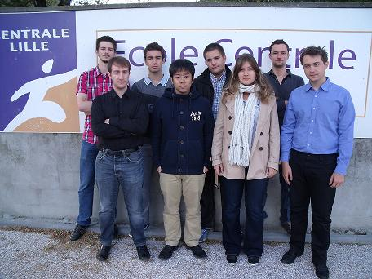
The project
The goal:
Prove the efficiency of a way to generate gravity
Use the rotational acceleration
Team of 8 students
Partners:
Association Planète Mars
Ecole Centrale de Lille
CNES
Novespace

Slide 5
The general idea
Module 1 contains a pulling system
The design is close to an actual space ship
acceleration
acceleration

Slide 6
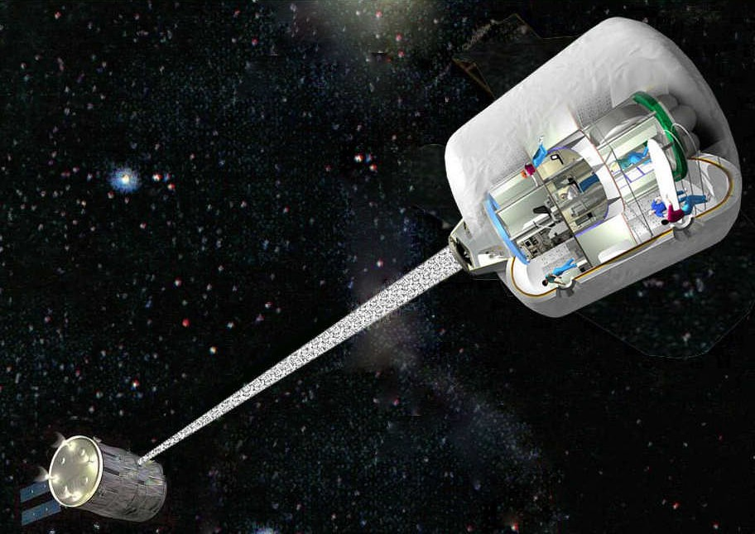

Slide 7
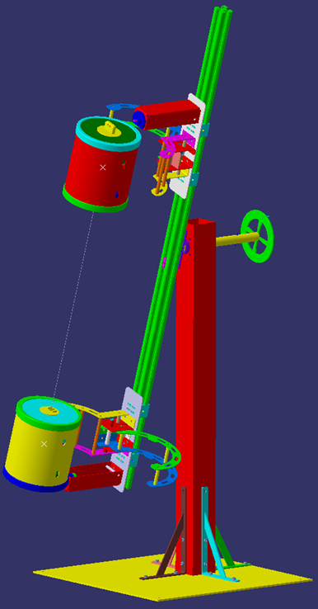
The conception
Launch
Transitory regime
Permanent regime
Rotation

Slide 8
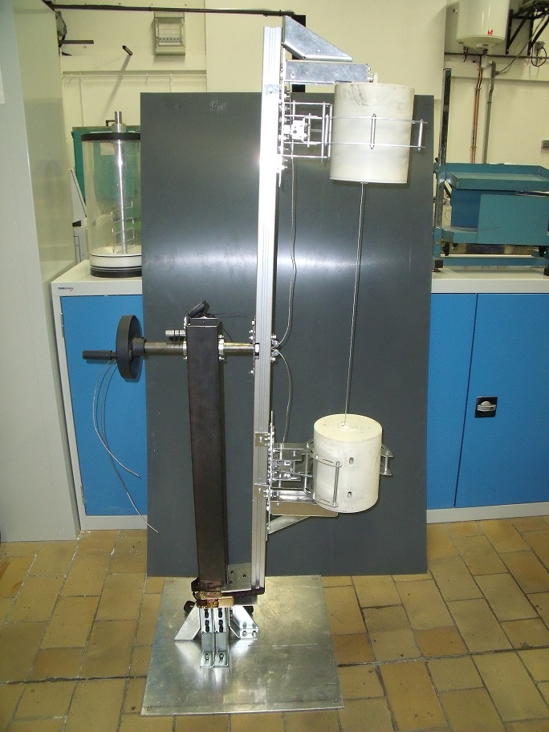
The conception

Slide 9
The demonstrator

Slide 10
The demonstrator
1 spring winch equipped module
1 accelerometer with a memory per module

Slide 11
The conception

Slide 12
The launcher

Slide 13
The launcher
1 pole fixed to a plate
1 perpendicular rotating arm
2 triggerrable pin+jaws systems

Slide 14
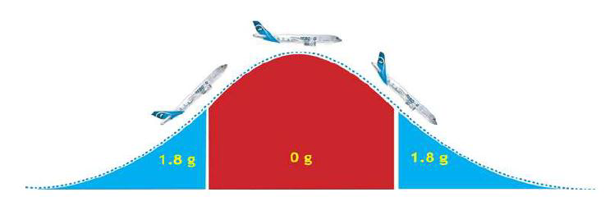
The flight
30 paraboles
Series of 5
22s of µ-gravity
90s between each

Slide 15
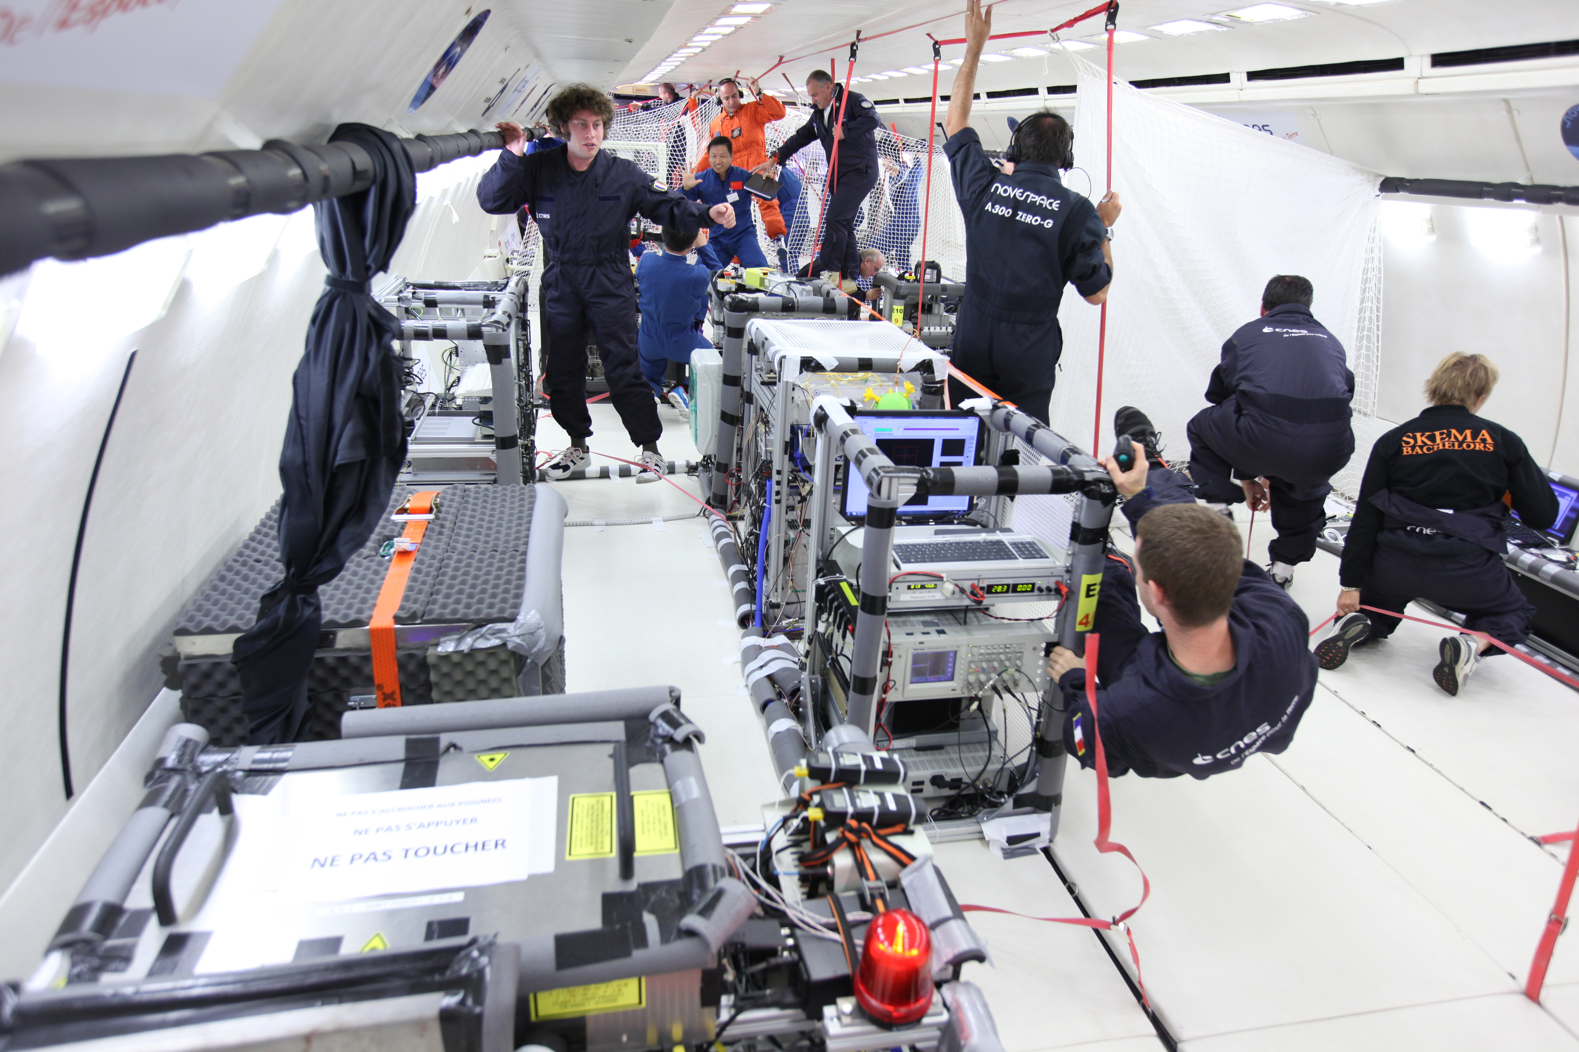
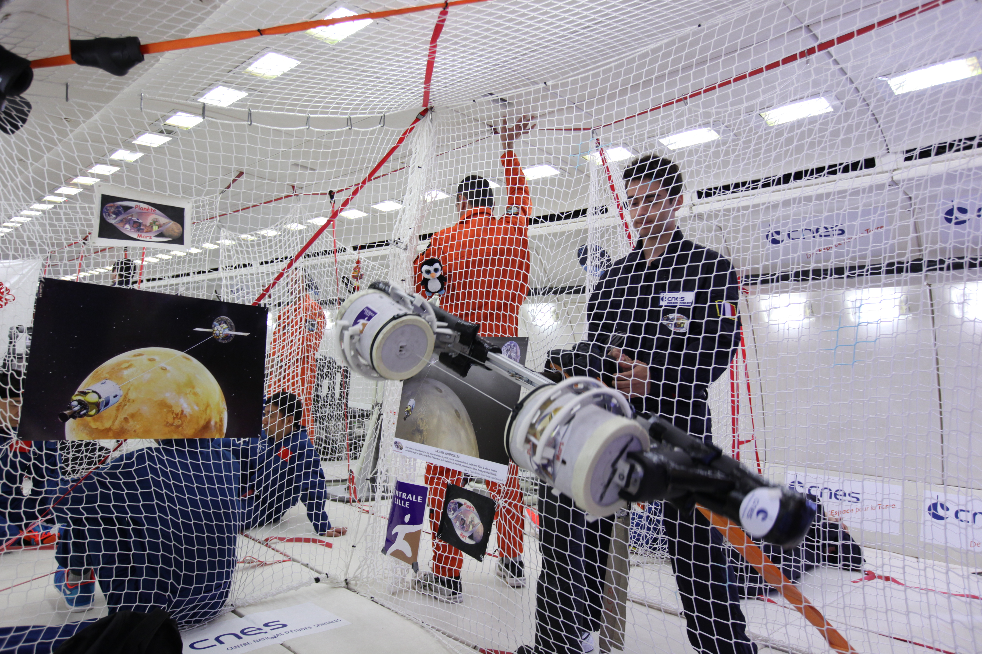
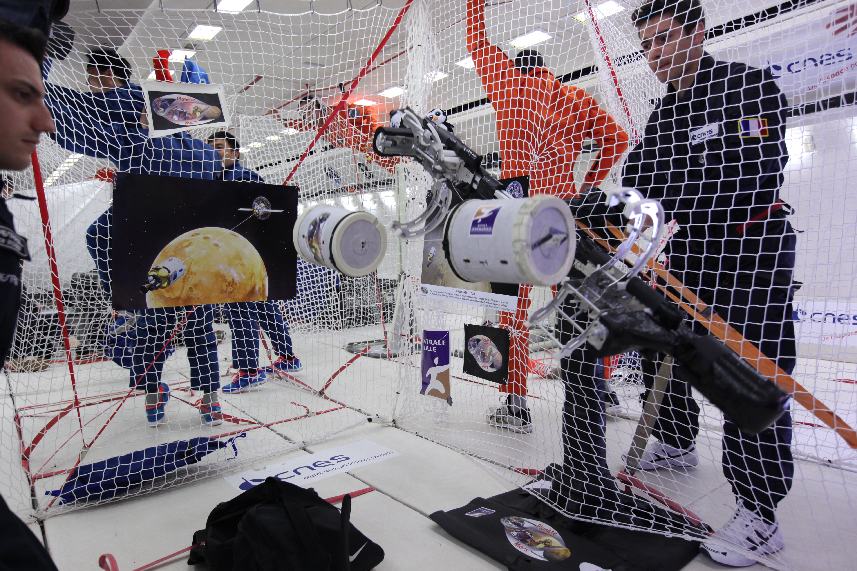
The flight

Slide 16
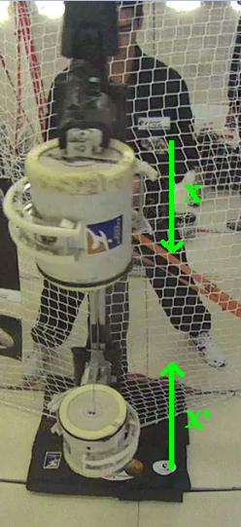
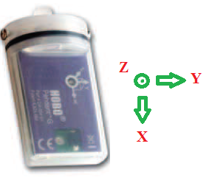
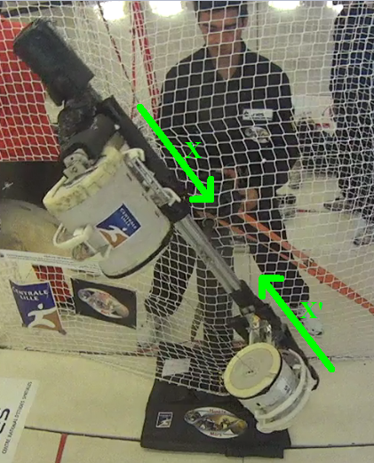
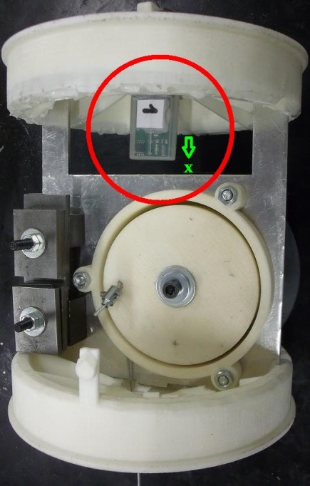
The results

Slide 17
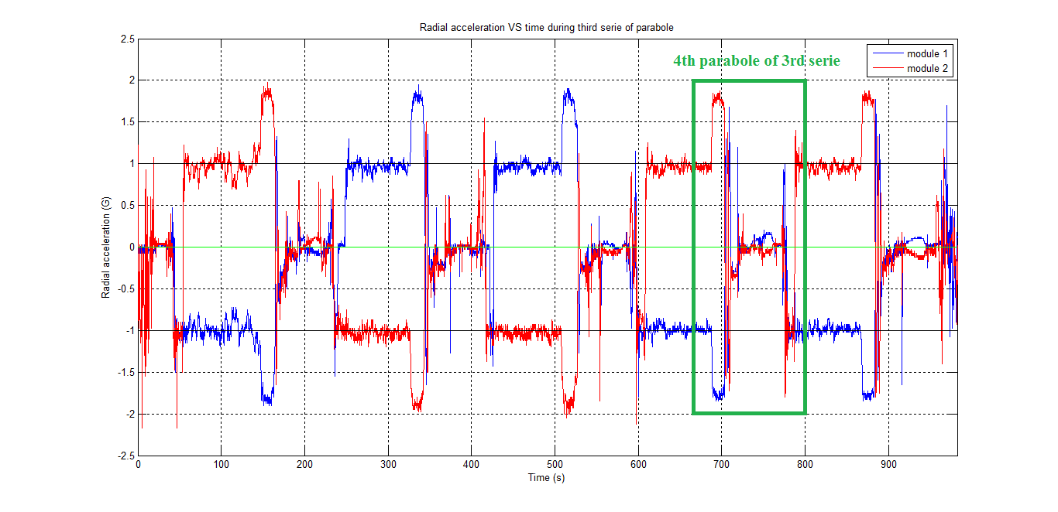
The results

Slide 18
The results

Slide 19
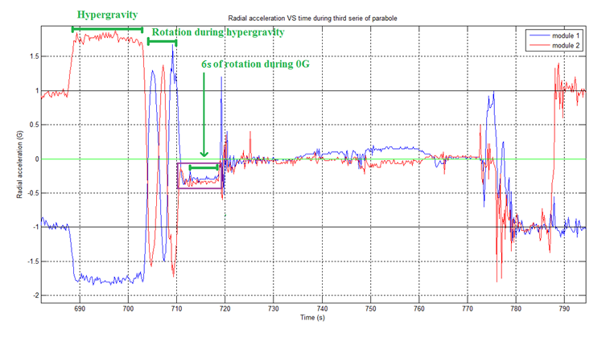
The results

Slide 20
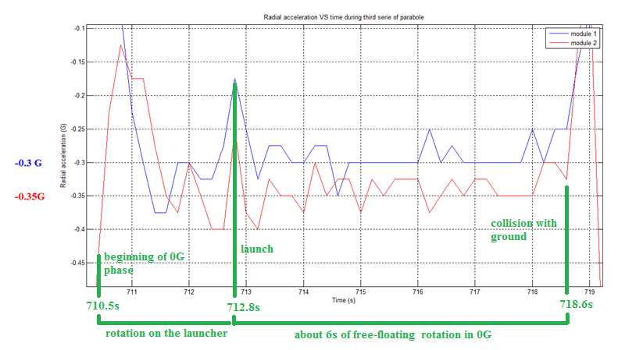
The results

Slide 21
Possible ameliorations
Enhance control of the launch speed
Use a controlable winch
Suppress parasite oscillations on the cable bases
Improve the reproductibility

Slide 22
Questions
Thanks for your attention !
For further information: www.marszerog.fr

Slide 23
Explanations
Module 1 ⬄ 1, Module 2 ⬄ 2 M = Mass R = distance of data logger to center of inertia (and rotation) G of demonstrator
Ae,i ex = - Ri*Ω² ex
M1/M2 = R2/R1 = r = 1,23 => R2 = r*R1 > R1 => |Ae,2| > |Ae,1|

Slide 24
4th parabole of 3rd serie
Ω_{t=0s} = 2,51 rad/s R_{1,t=0s} = 0,365 m R_{2,t=0s} = 0,435 m
|A_{e,1,t=0s,th}| = 0,23 G |A_{e,2,t=0s,th}| = 0,28 G
|A_{e,1,t=0s,exp}| = 0,18 G |A_{e,2,t=0s,exp}| = 0,27 G

